Slide 1
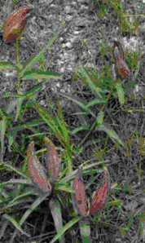
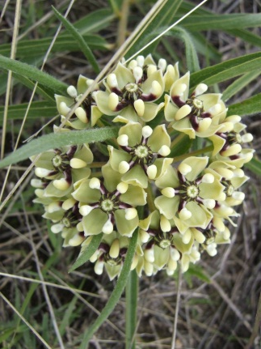
Antelope Horns
Asclepias asperula
Open here
Antelope Horns
Asclepias asperula

